Slide 1



Bird strike Analysis dashboard
View in Power BI
Last data refresh:
5/11/2024 8:36:36 AM UTC
Downloaded at:
5/14/2024 2:45:26 PM UTC

Slide 2
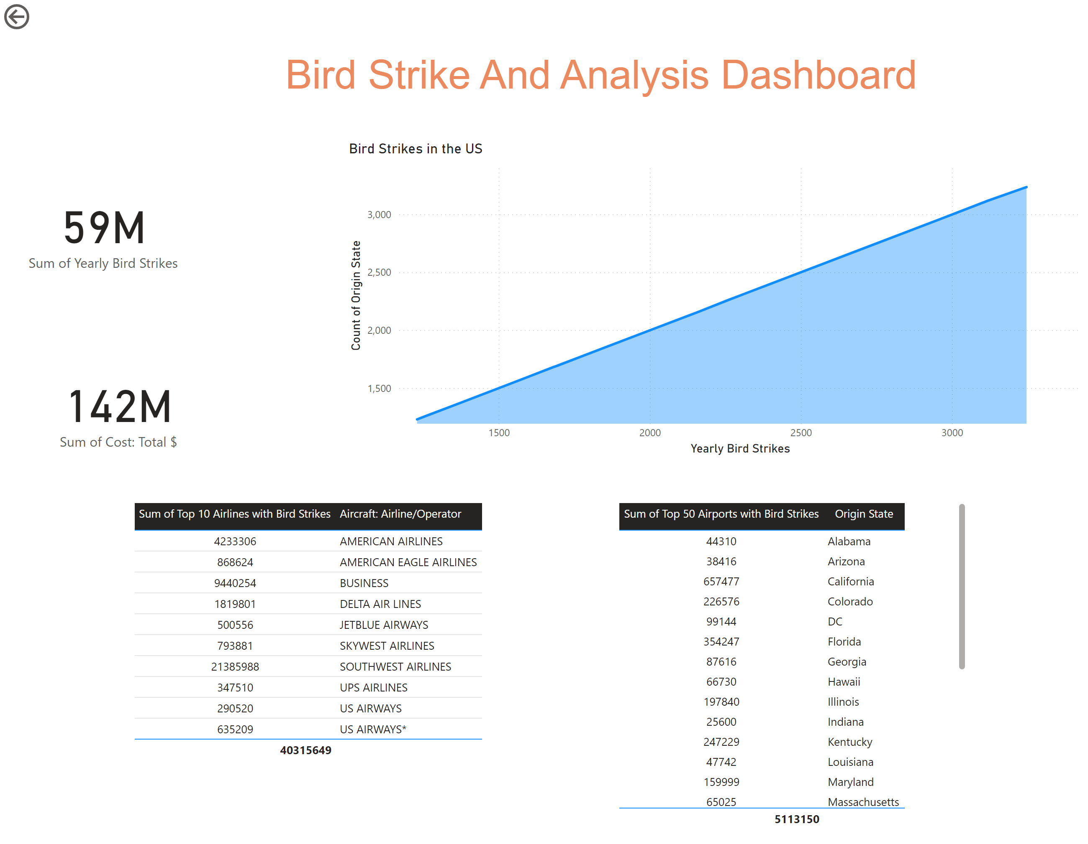
Page 1
Notes:
card
No alt text provided
textbox
No alt text provided
Bird Strikes in the US
No alt text provided
actionButton
No alt text provided
tableEx
No alt text provided
tableEx
No alt text provided
card
No alt text provided

Slide 3
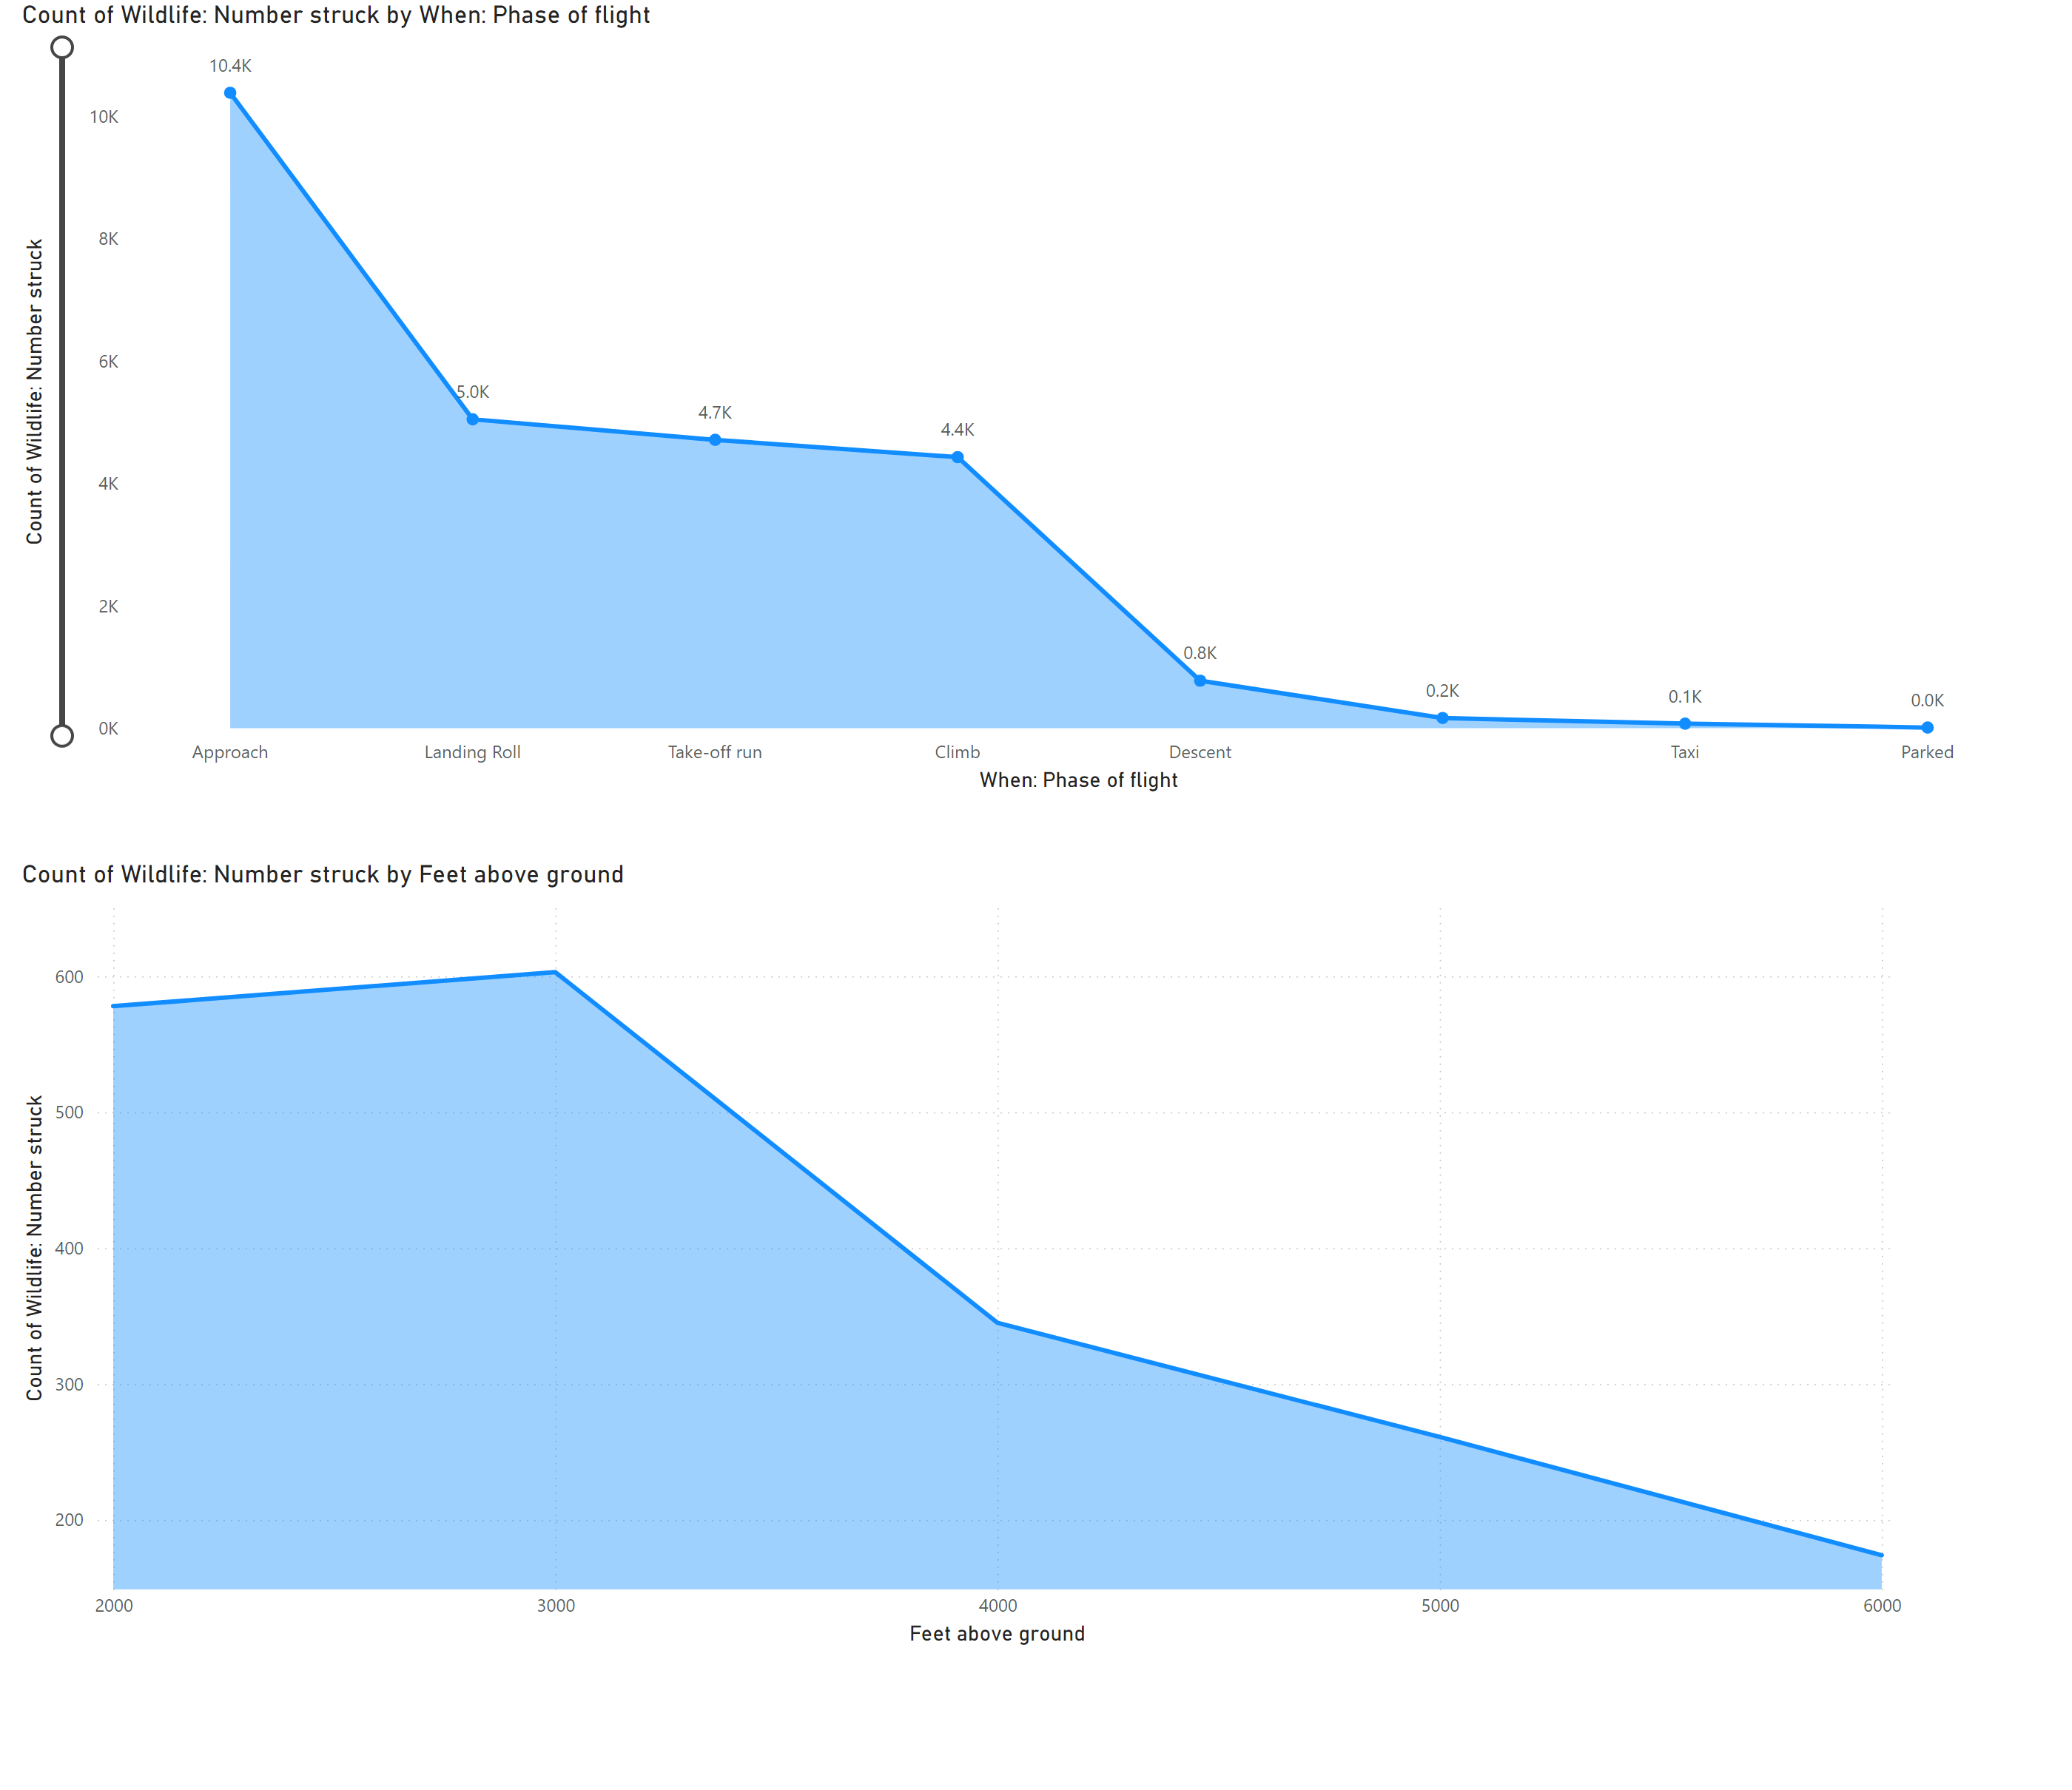
Page 2
Notes:
areaChart
No alt text provided
stackedAreaChart
No alt text provided

Slide 4
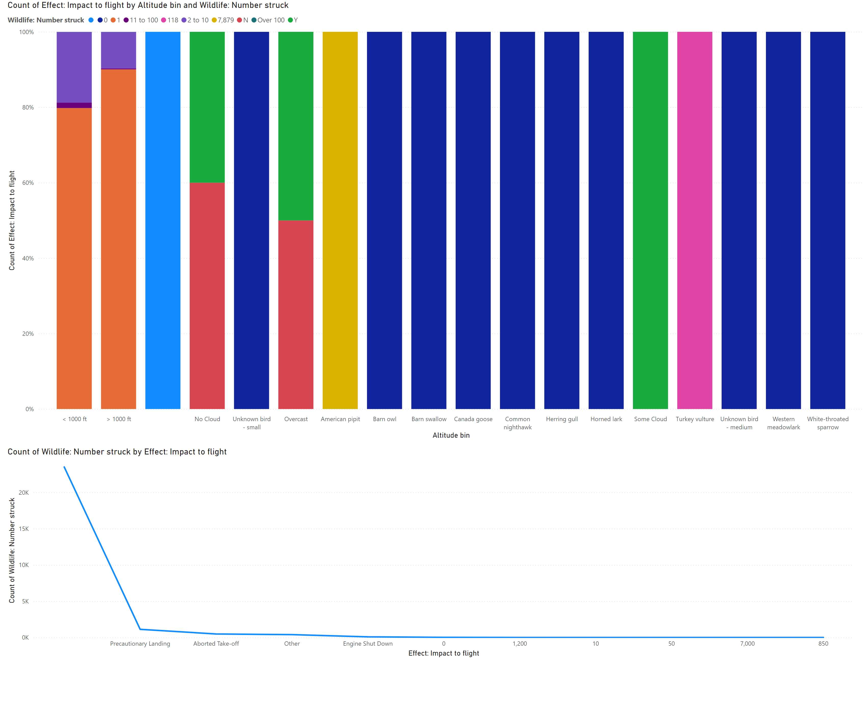
Page 3
Notes:
hundredPercentStackedColumnChart
No alt text provided
lineChart
No alt text provided

Slide 5
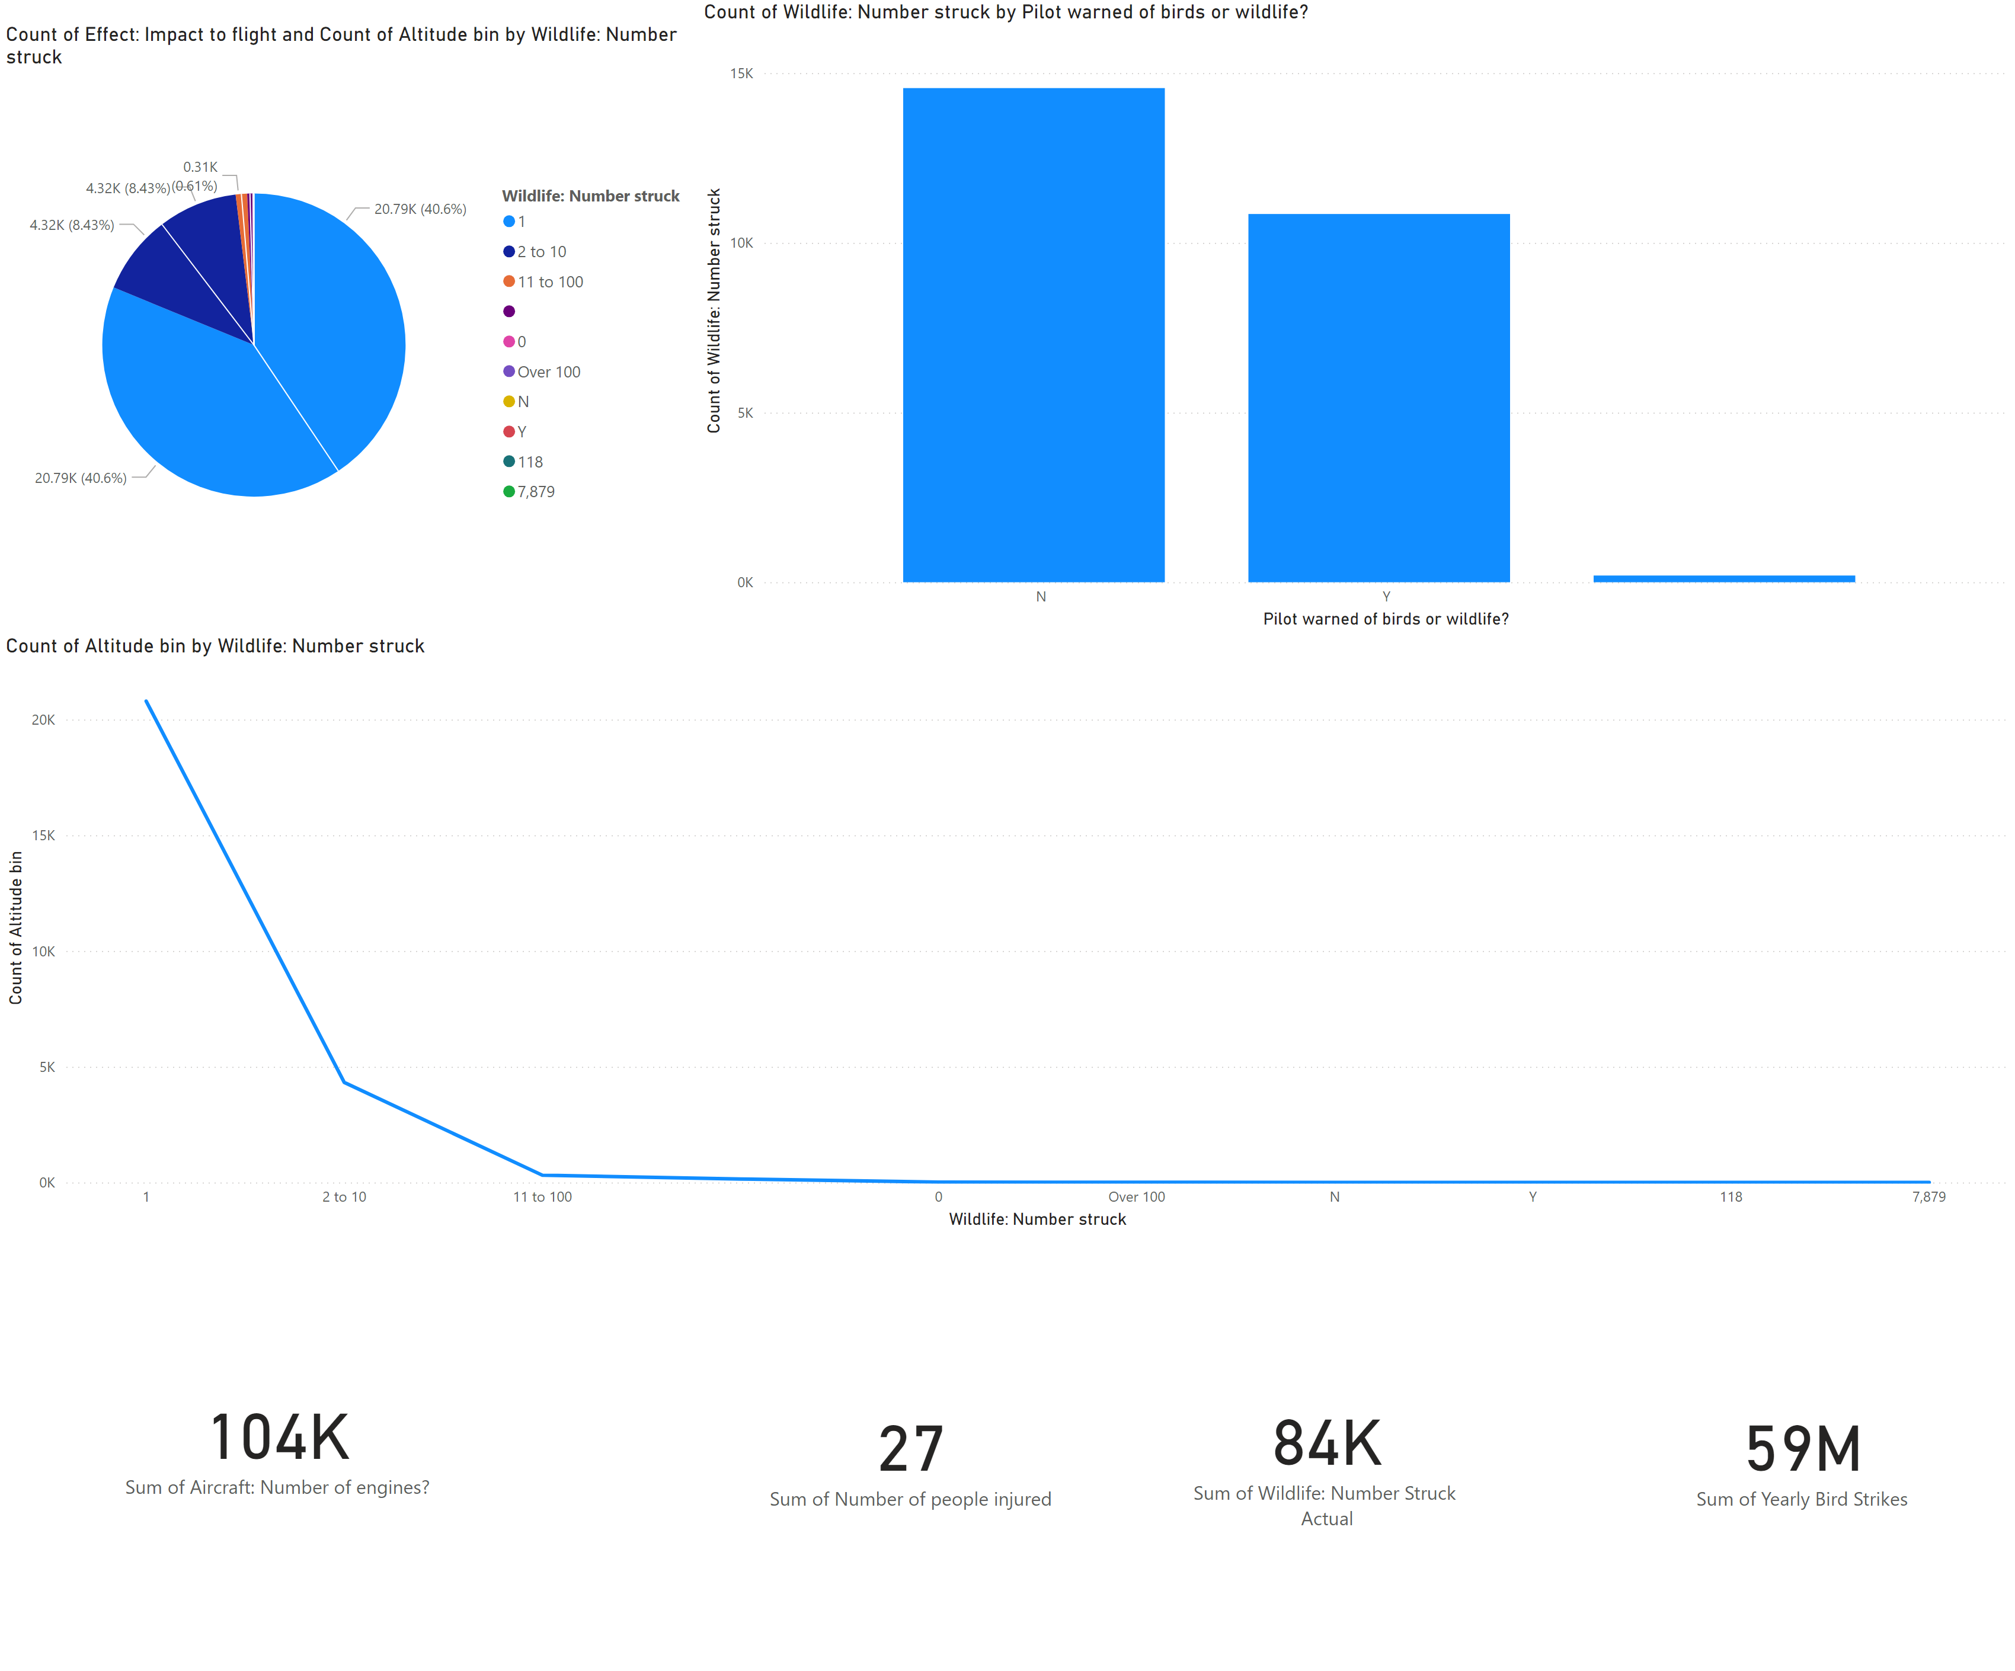
Page 4
Notes:
card
No alt text provided
lineChart
No alt text provided
pieChart
No alt text provided
card
No alt text provided
card
No alt text provided
card
No alt text provided
lineClusteredColumnComboChart
No alt text provided

